Slide 1
Flip Flop Fun!
Presented By Mark Thoren

Slide 2
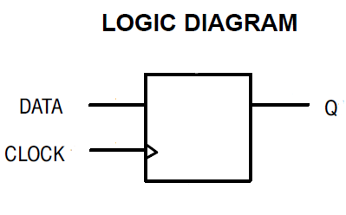
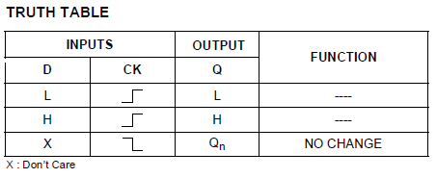

What is a Flip Flop?
The fundamental element of sequential logic
“When a rising clock edge comes along, copy whatever is at the DATA input to the Q output”
Questions:
How soon before the clock edge must the data be present? (or “set up”)
How long after the clock edge must the data be “held”
After the clock edge, how long does it take for the data to “propagate” from D to Q?
Copy

Slide 3
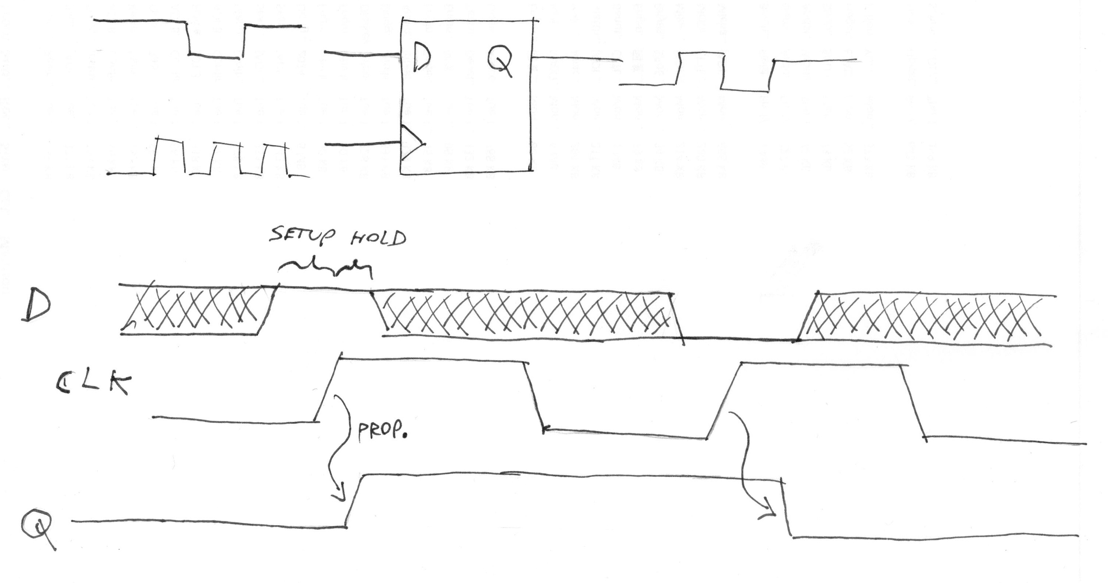
Timing Details

Slide 4


Preview: Thoren’s Favorite Interview Question
Tie Data and Clock together, and drive with a square wave
Question:
Does Q go Low or High?

Slide 5
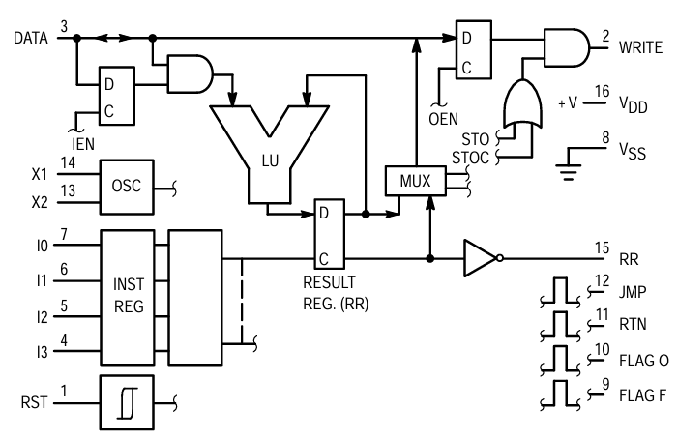
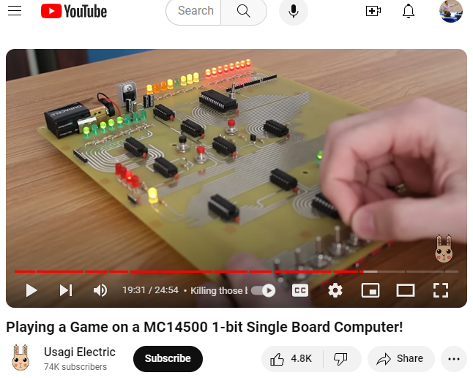
Why Care? FPGAS, and lots of other parts, are filled with flip flops
Anything that stores a digital state has a flip-flop or latch somewhere
SRAM: A bunch of individually addressable flip-flops
Microprocessor – flip flops wrapped with logic and control
MC14500 1-bit “Industrial Control Unit” Block Diagram
Gaming on a 1-bit computer? You bet!
1-bit result flip-flop (register)

Slide 6
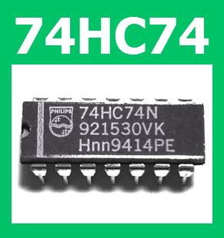
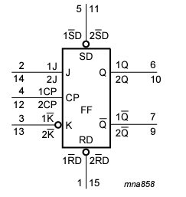
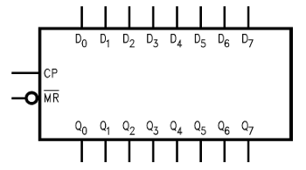

You can also buy them as “discrete” components
74x74 - Dual D-type Flip-Flop with Set and Reset
74x109 – Dual J-K FF with Reset
74x273 – Octal D FF (with global reset
74x273

Slide 7
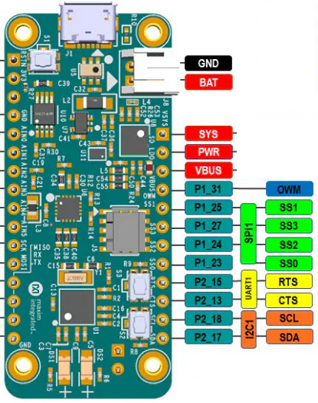
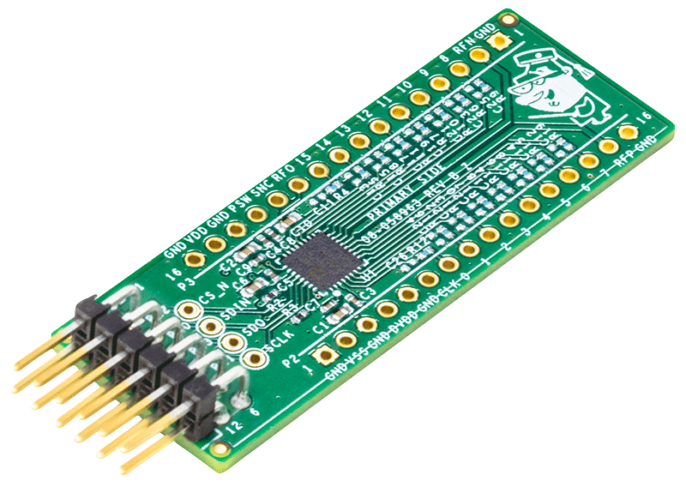
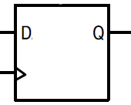
Typical SPI Controller / Target Relationship
Controller (MAX32690 Microcontroller)
Target (AD7124-8 ADC)
Serial Peripheral Interface (SPI)
D8 | D7 | D6 | D5 | D4 | D3 | D2 | D1 | D0
D8 | D7 | D6 | D5 | D4 | D3 | D2 | D1 | D0
Data to Transmit
Data to Transmit
CS
CS
…
SCK
…
SCK
D8 | D7 | D6 | D5 | D4 | D3 | D2 | D1 | D0
MOSI
D8 | D7 | D6 | D5 | D4 | D3 | D2 | D1 | D0
MISO
CS
CS
CS
Data Recieved
Data Recieved
D8 | D7 | D6 | D5 | D4 | D3 | D2 | D1 | D0
D8 | D7 | D6 | D5 | D4 | D3 | D2 | D1 | D0

Slide 8
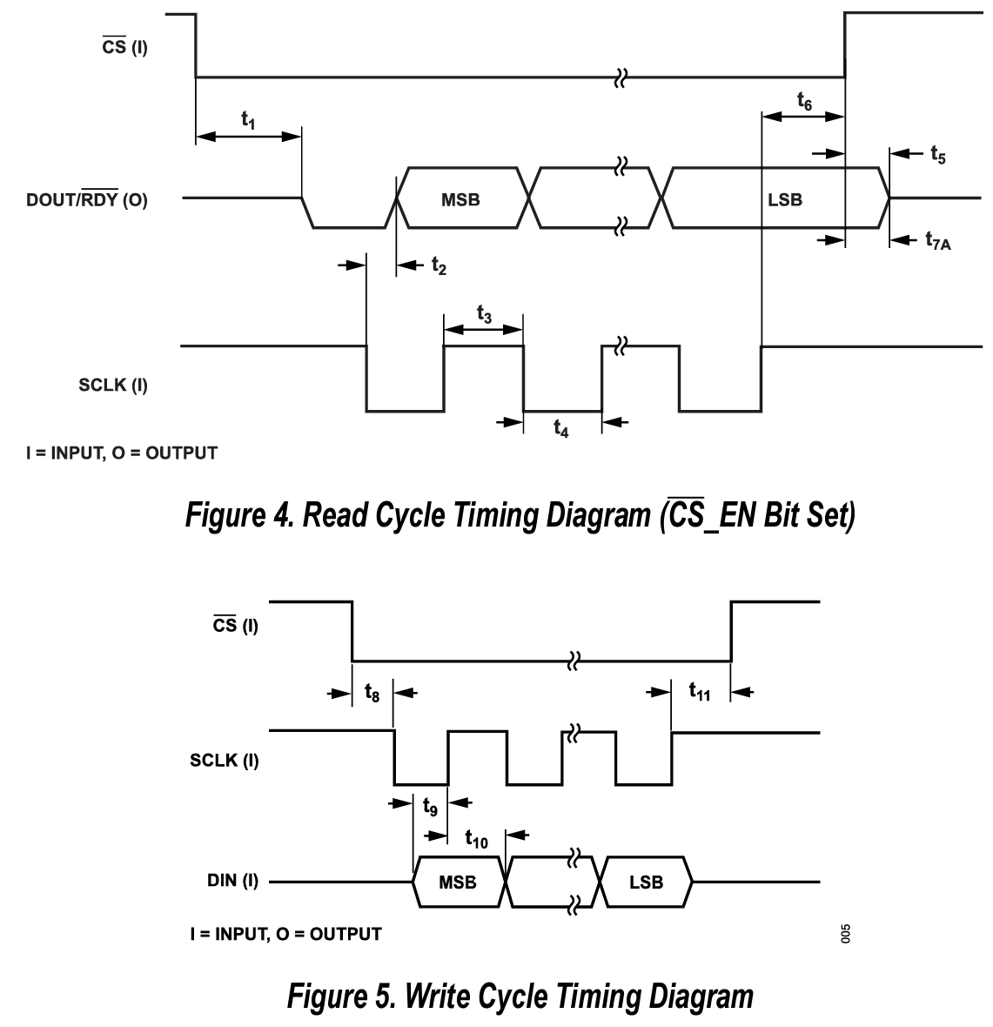
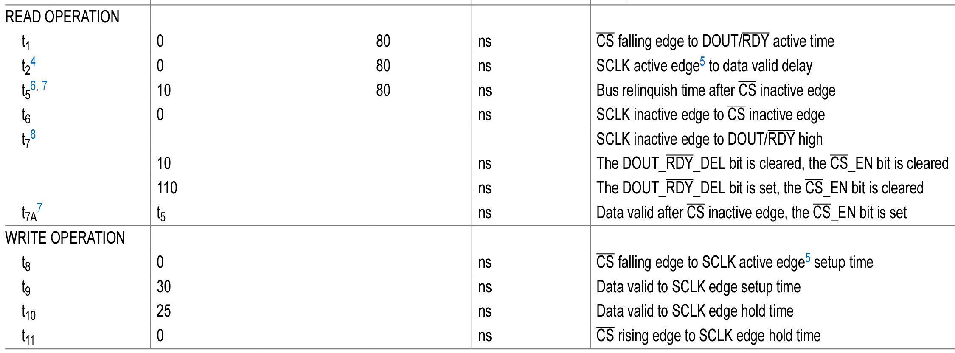
AD7124-8 SPI Interface Timing Specs

Slide 9
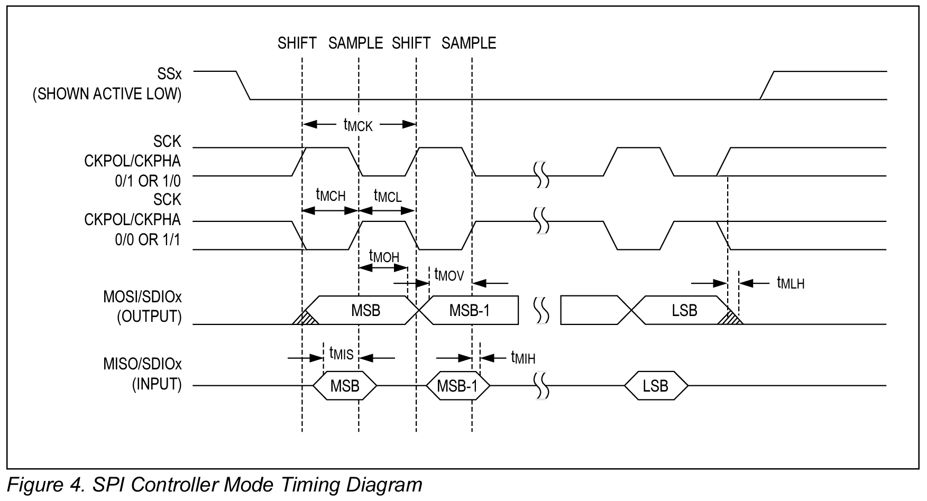
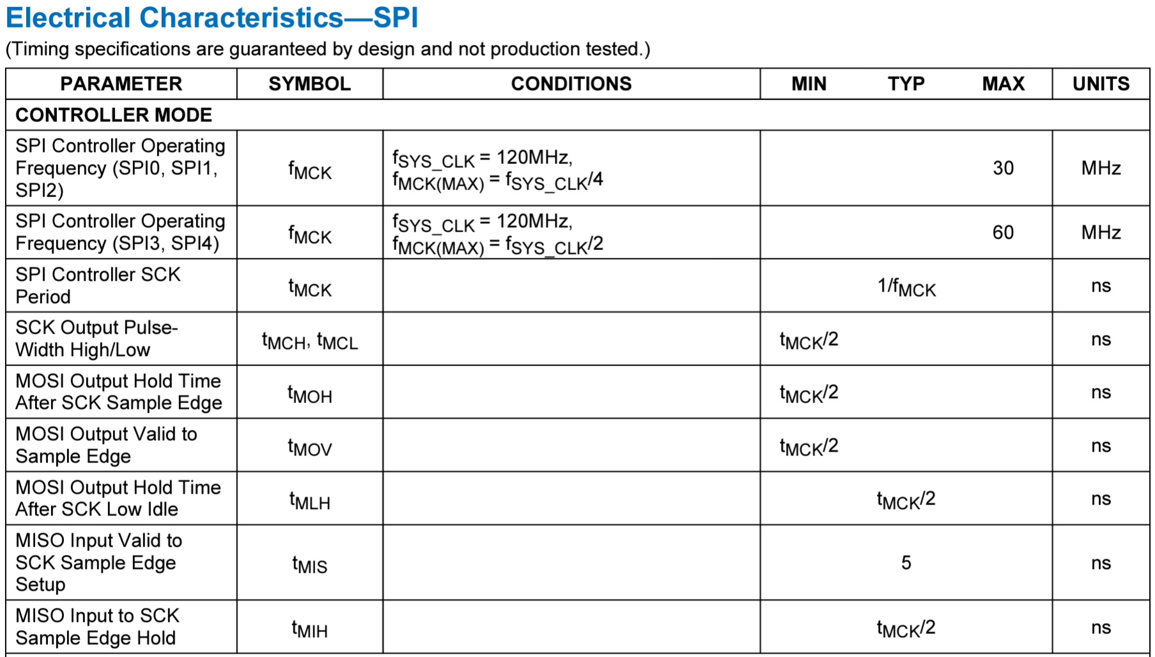
MAX32690 µC SPI Interface Timing Specs

Slide 10
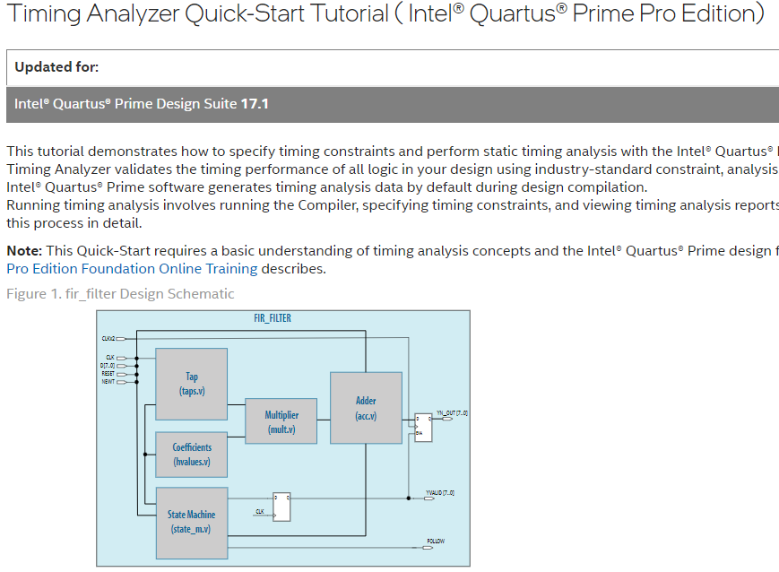
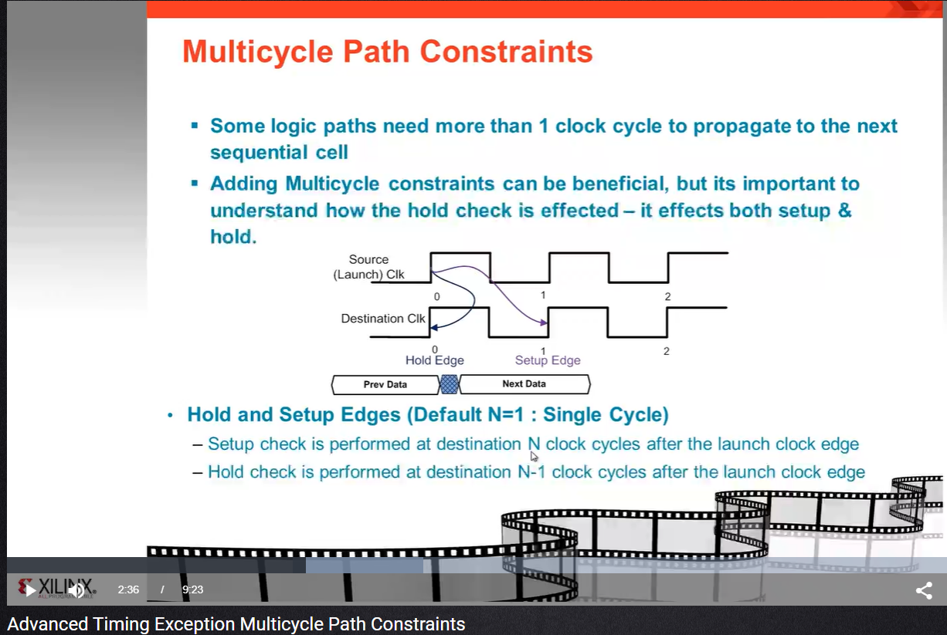
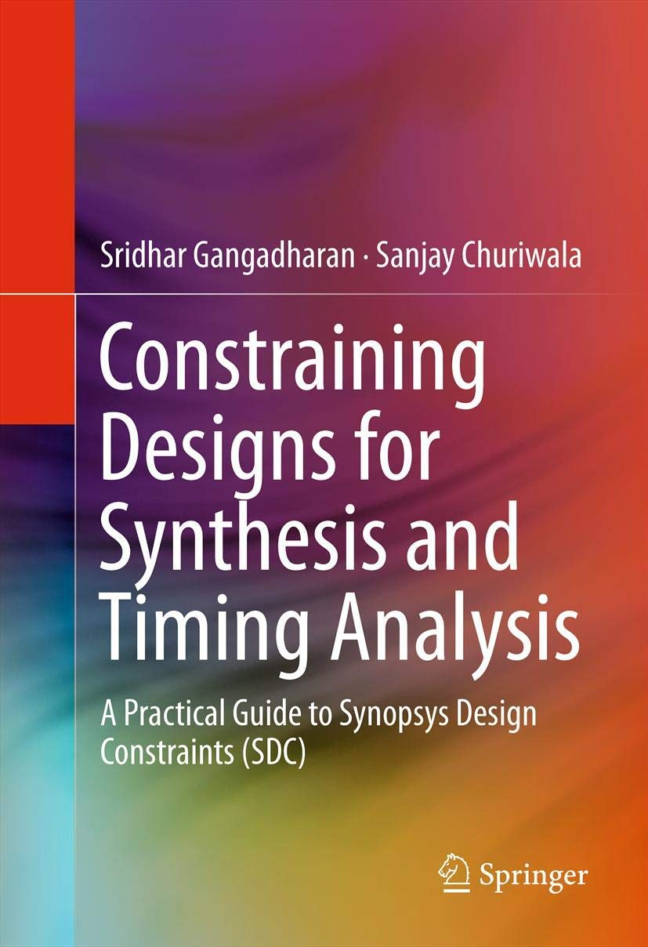
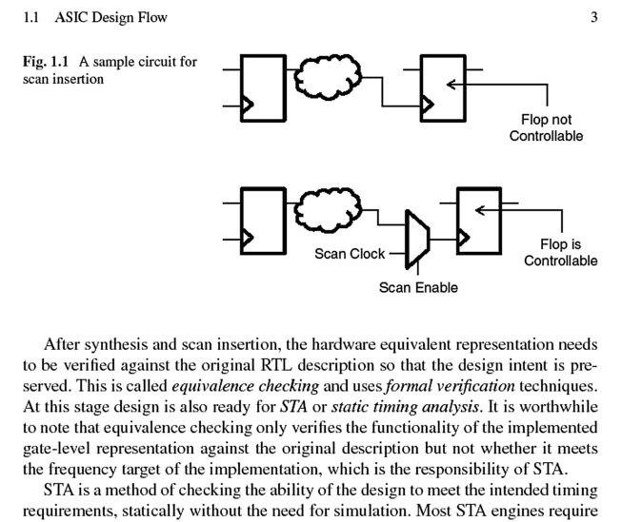
FPGAs have more “knobs” (Timing Constraints)
Tell the FPGA tool the peripheral’s timing requirements, and it will try to meet them (and let you know if it can’t)
But this is a rabbit hole for another day…

Slide 11
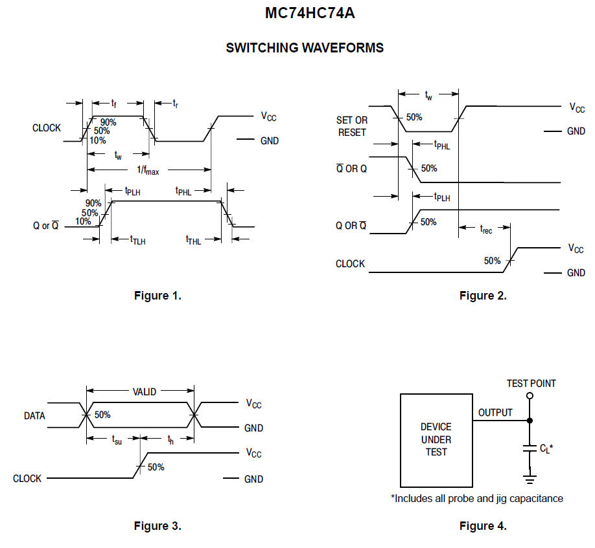
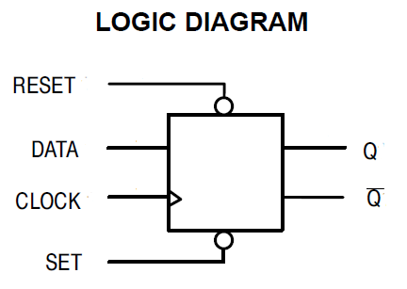
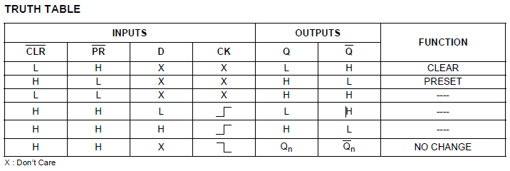
74HC74 Refresher

Slide 12
Timing
5 leading manufacturers…
 | NXP min typ max |  |  | ST min typ max |  |  | ON min typ max |  |  | Fairchild min typ max |  |  | Toshiba min typ max
t_{setup}@2.0V | 75 | 6 |  | 75 | 15 |  | 80 |  |  | 80 | 35 |  | 75
t_{setup}@4.5V | 15 | 2 |  | 15 | 4 |  | 16 |  |  | 16 | 10 |  | 15
t_{setup}@6.0V | 13 | 2 |  | 13 | 3 |  | 14 |  |  | 14 | 8 |  | 13
t_{hold}@2.0V | 3 | -6 |  | 0 |  |  | 3 |  |  | 0 |  |  | 0
t_{hold}@4.5V | 3 | -2 |  | 0 |  |  | 3 |  |  | 0 |  |  | 0
t_{hold}@6.0V | 3 | -2 |  | 0 |  |  | 3 |  |  | 0 |  |  | 0
t_{prop}@2.0V |  | 47 | 220 |  | 48 | 150 |  |  | 100 |  | 34 | 110 |  | 51 | 150
t_{prop}@4.5V |  | 17 | 44 |  | 16 | 30 |  |  | 20 |  | 12 | 22 |  | 17 | 30
t_{prop}@6.0V |  | 14 | 37 |  | 13 | 26 |  |  | 17 |  | 10 | 19 |  | 15 | 26
Zero Hold implies: data and clock can change simultaneously☺

Slide 13
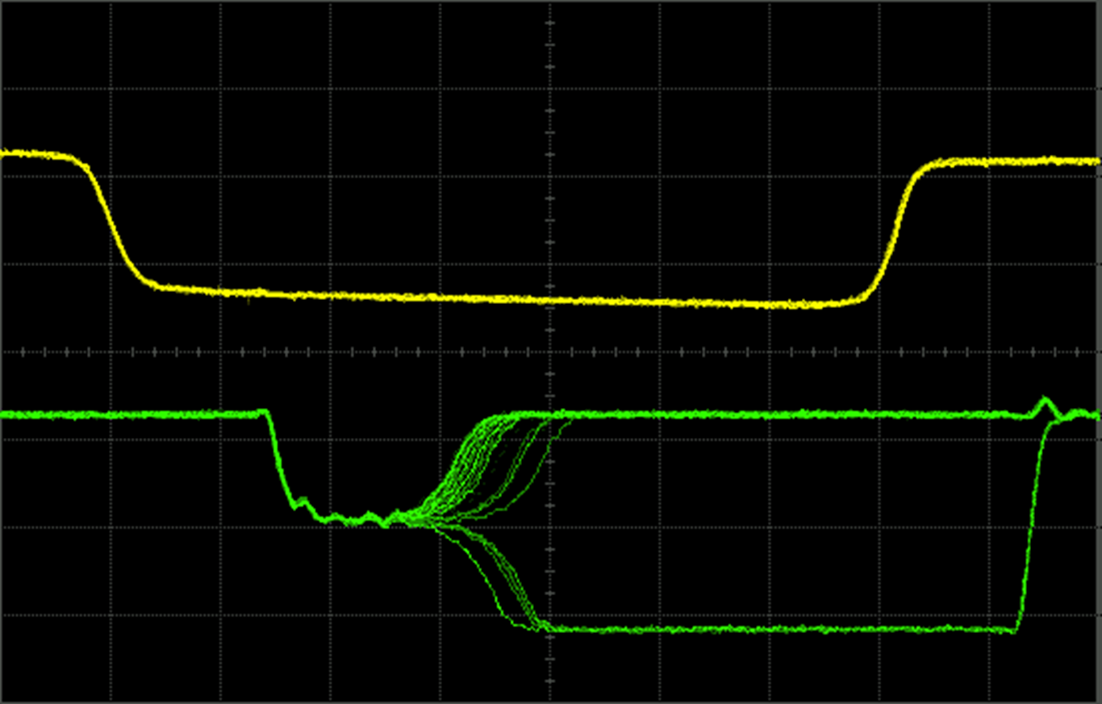
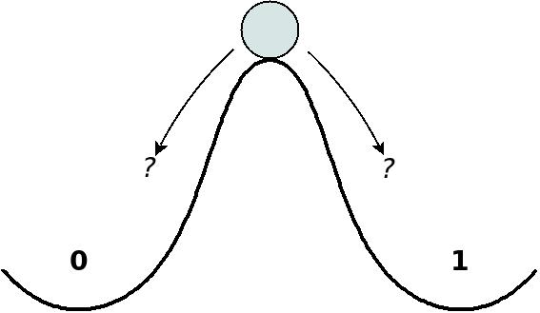
What happens when you just barely violate timing?
“Metastability”! Another rabbit hole we’re about to dive into.
Source:
01signal: Metastability and the basics of clock domain crossing. (n.d.). https://www.01signal.com/verilog-design/clockdomains/crossing-basics/
Source:
W. J. Dally, Lecture notes for EE108A, Lecture 13: Metastability and Synchronization Failure (When Good Flip-Flops go Bad) 11/9/2005.
(Also essential reading from 01signal: “Electronic Exorcism: Why FPGAs sometimes behave as if they are possessed”)

Slide 14
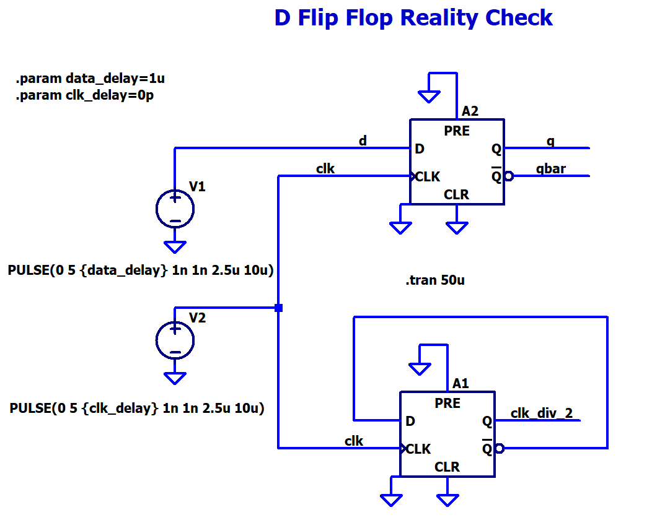
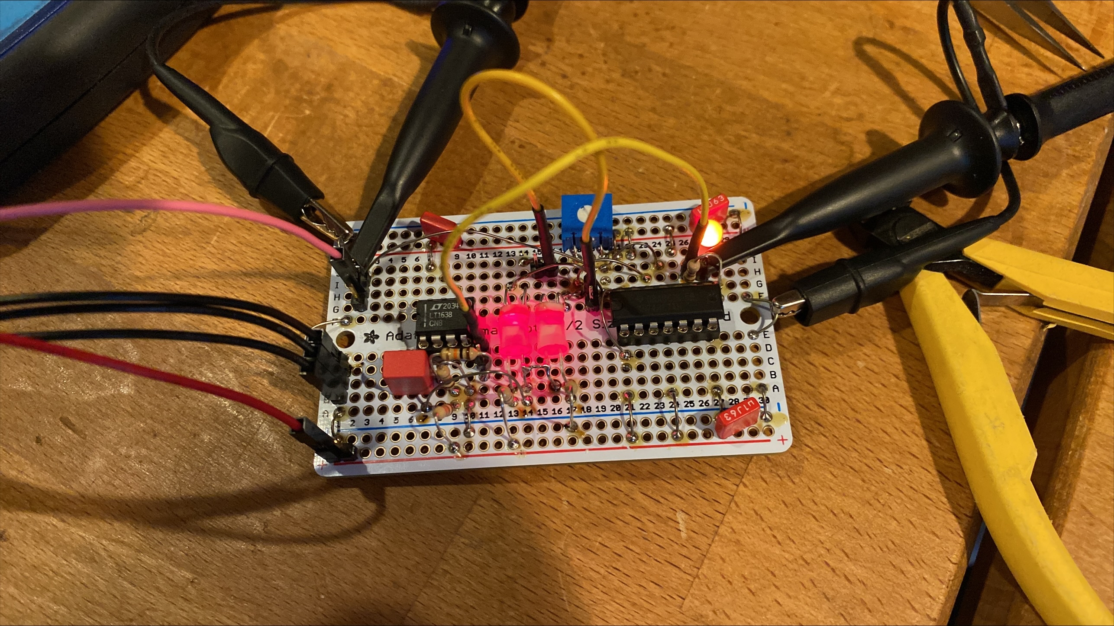
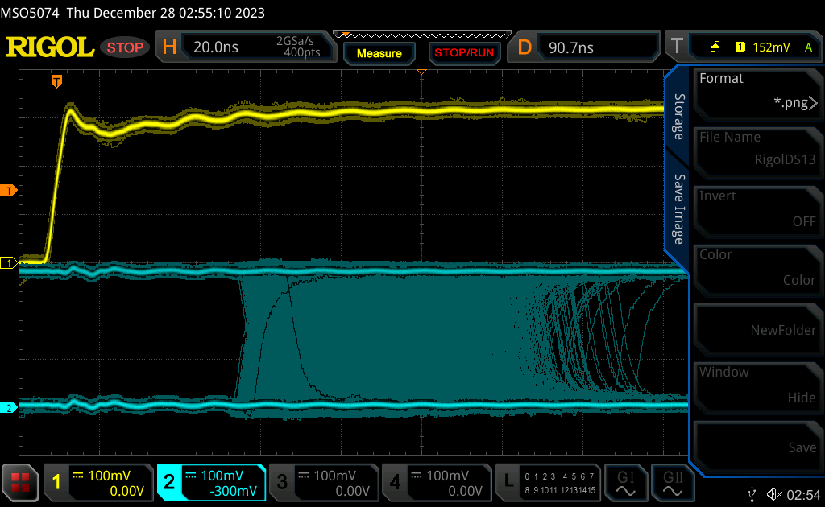
Let’s Design Some Circuits…
Then build…
Then test…

Slide 15
Input Thresholds
5 leading manufacturers…
 | NXP min typ max |  |  | ST min typ max |  |  | ON min typ max |  |  | Fairchild min typ max |  |  | Toshiba min typ max

Slide 16
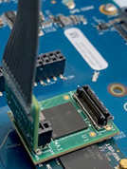
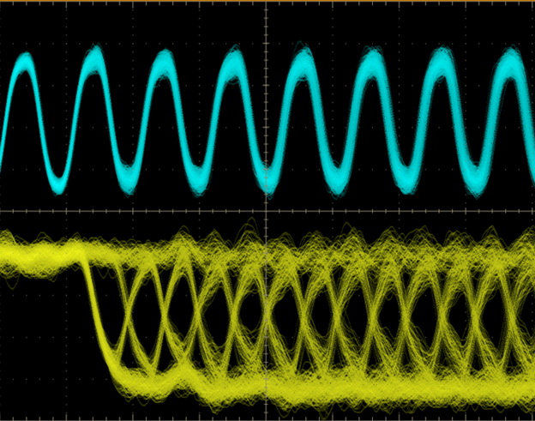
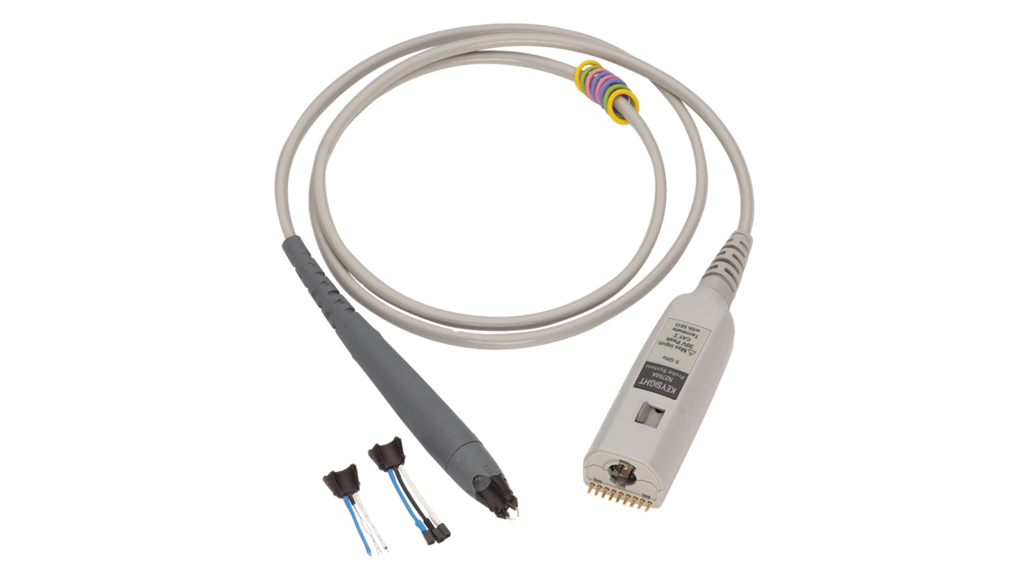
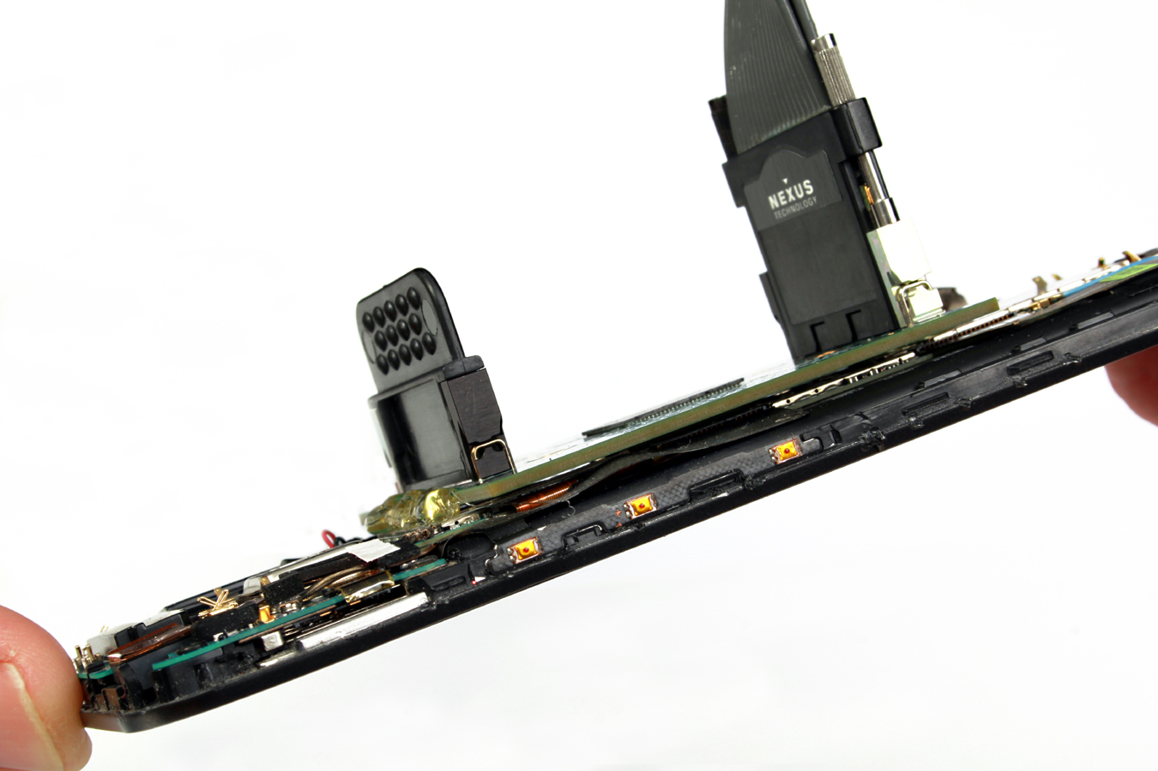
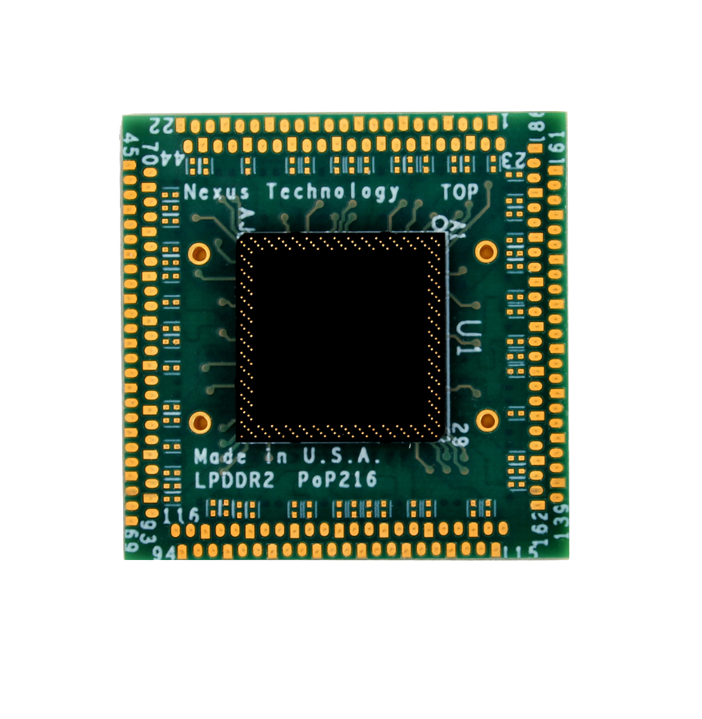
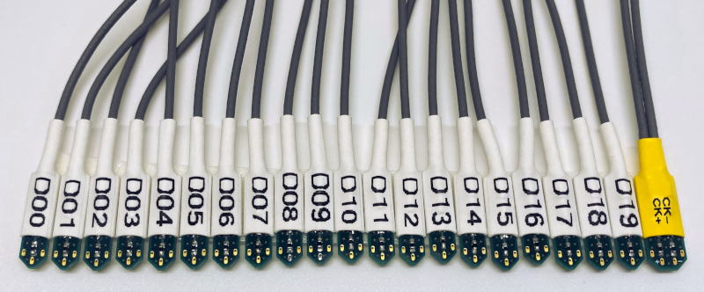
Probing…
Sometimes probing is “inaccessible technology”
Agilent N2750 1.5 GHz diff probe: $4800
U1818A 7 GHz diff probe: $9500
Nexus Technology interposers and probes… don’t ask.

Slide 17
Microcontroller/processor peripherals
EVERY input and output has a flip flop (or “register”) at some point
UART, I2C, and SPI are “shift registers”, or strings of flip flops
UART – Shift register clocked at a fixed rate
SPI – Controller and target shift registers share a common clock
I2C – Defined timing requirements

Slide 18

Thank You! <and/or> Questions? <and/or> Section Slide

